Slide 1
“Keep It Moving” (Generating Academic Success in Accounting)
2023 Conference of Minnesota/Midwest Accounting Educators Conference
Saint Cloud, May 25, 2023
Dr. Bill Joyce, Bemidji State University

Slide 2
Abstract:
Overcoming failure in the first accounting course will, in part, work toward Minnesota State’s Equity 2030 Goal.
Elements of overcoming failure in the first accounting course include: defining failure; reactions to failure; repetition; reflection; environment and communication.
Consider adding an additional freshman-level pre-introductory accounting course for students with no high school accounting.

Slide 3
Minnesota State’s Equity 2030 Goal

Slide 4
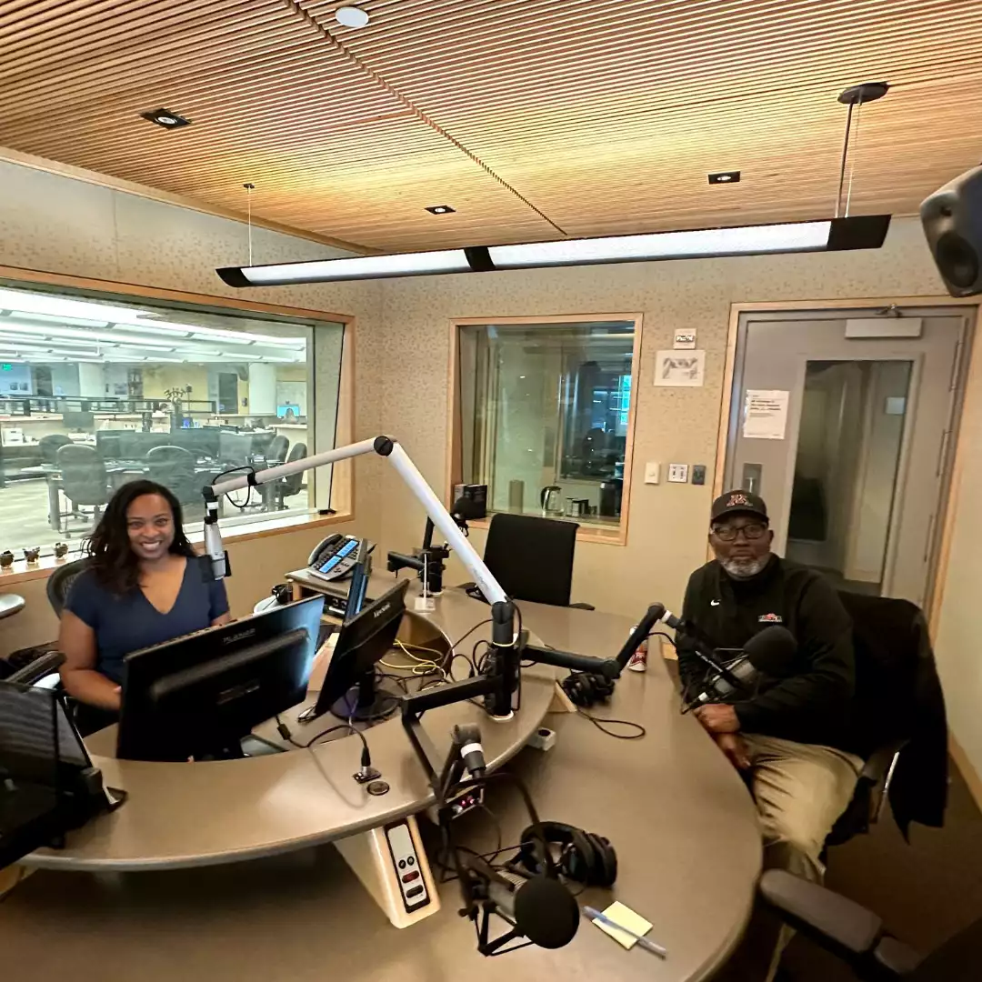
Introduction: “Losing is Learning”
MPR News host Angela Davis talked with longtime high school boys basketball coach Larry McKenzie.
McKenzie was the first coach in Minnesota history to win six basketball state titles.
Davis asked, “How do you teach student-athletes how to lose?”

Slide 5
Larry McKenzie, “Losing is Learning”
McKenzie was the first coach in Minnesota history to win six basketball state titles.

Slide 6
“How do you teach student-athletes how to lose?”
“You always find life lessons in the loss.
Losing is learning.
One of the things that I always try to do in losing is taking that opportunity and transfer it into a life experience.
In life, everything doesn't go the way that you want it to go, you're gonna have some ups and downs,
so you have to learn to stay in the moment, get up, dust yourself off and get going again….”
Larry McKenzie, 2023: Continued

Slide 7
“You got to keep it moving.” Larry McKenzie
One of the things that I particularly used to tell my young men is that there are situations where you will lose, but if you have kids, and you have a house payment and those kinds of things, you don't have a whole lot of time to sit around and feel sorry for yourself. You got to keep it moving.” Larry McKenzie, 2023.

Slide 8
What is Success? Emerson
To laugh often and much;
To win the respect of intelligent people and the affection of children;
To earn the appreciation of honest critics and endure the betrayal of false friends;
To appreciate beauty; To find the best in others;
To leave the world a bit better, whether by a healthy child, a garden patch
or a redeemed social condition;
To know even one life has breathed easier because you have lived;
This is to have succeeded.
Ralph Waldo Emerson

Slide 9
Student Success: Kim
There is much debate on how to define and measure student success. At first glance, it seems simple: a successful student is a first-year who enrolls in college full-time, persists through terms, and then progresses to degree completion.

Slide 10
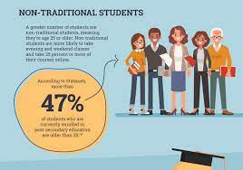
However: Kim
However, the routes students take in higher education are seldom this traditional and straightforward. Factors such as incoming/outgoing transfer students, dropouts, and academic suspension add to the complexity.
Are students who transfer to other institutions and graduate with a degree a success?
The struggle is trying to understand these enrollment patterns and to predict a student’s academic career.

Slide 11
5 Common Metrics used in Student Success
The five most commonly seen metrics used in student success: retention rates, graduation rates, time to completion, academic performance, and tracking educational goals.

Slide 12
Joyce 2023
Elements of overcoming failure in the first accounting course include: defining failure; reactions to failure; repetition; reflection; environment and communication.

Slide 13
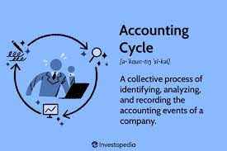
(Eskew & Faley, 1988)
(Eskew & Faley, 1988) have called for either an additional freshman-level pre-introductory accounting course for students with no high school accounting,
or else the splitting of the first introductory course into sections for students with and without high school accounting.

Slide 14
Summary and Conclusion
*Defining student success is often difficult and confusing. There may never be complete agreement on how student success should be defined.
* The five most commonly seen metrics used in student success: retention rates, graduation rates, time to completion, academic performance, and tracking educational goals.
*Students with no high school accounting should be warned that their initial difficulty is temporary, and that students with high school accounting should be warned not to be overly confident
Consider an additional freshman-level pre-introductory accounting course

Slide 15
References
Eskew, R. and R. Faley, 1988. Some determinants of student performance in the first college-level financial accounting course. The Accounting Review, (January), pp. 137-147.
Joyce, B., 2023. The Gain in Loss (Overcoming Failure in First Accounting Course). MBAA Internal Conference Chicago, March 22-24
Kim, J 2017. The 5 Most Commonly Found Metrics for Student Success. Envisions. https://www.evisions.com/resources/blog/5-commonly-found-metrics-student-success/

