Slide 1
Financial Statement Analysis Using Ratios - 2022
Boz Bostrom, CPA
Professor of Accounting and Finance
Saint Ben’s / Saint John’s
bbostrom@csbsju.edu / (612) 414-9629
https://www.linkedin.com/in/bozbostrom/
June 30, 2022
1
Notes:
1

Slide 2
Logistics
Polling questions throughout the meeting
Required for CPE
If you have issues answering the polling questions, please chat or email across your answer
2.0 CPE Hours (Finance - Technical)
Partial credit available – minimum of 1.0 hour
Questions are very welcome, submit through chat at any time
Course evaluation and CPE certificate will be emailed shortly after the session

Slide 3
Learning objectives / Agenda
Understand key ratios to use in evaluating financial statements
Understand how to assess a company’s performance over time
Understand how to assess a company’s performance against its peers

Slide 4
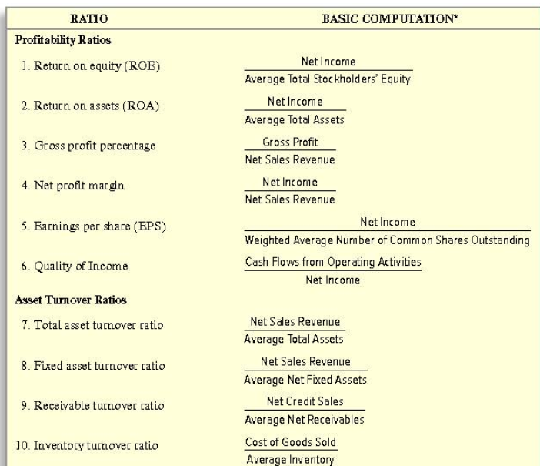
What ratios should we use? From a leading Financial Accounting textbook

Slide 5
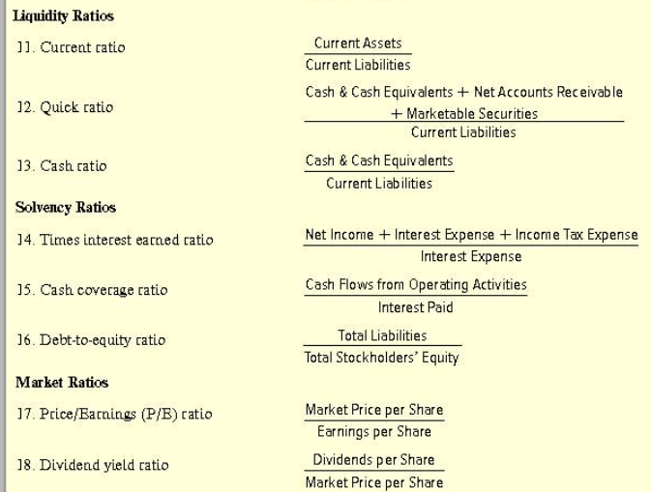
What ratios should we use? From a leading Financial Accounting textbook

Slide 6
What is your favorite financial ratio and why?
“Can I pick one balance sheet ratio and one income statement ratio? I like debt to equity because I think it’s generally interesting to know how companies are funded/how leveraged they are. I think net profit margin is just generally interesting as well and how it widely varies among industries, etc”
“Rough question. Two. Debt to equity for long term solvency. Quick ratio for cash flow.”
“ROI. I make a lot of personal decisions based on ROI.”
“Probably the current ratio as it is the only one I know off the top of my head.”

Slide 7
What is your favorite financial ratio and why?
“Times interest earned. We think debt is bad but it shows how leverage is powerful. Most useful is PE, buy low and sell high.”
“This is kind of cheating as it isn’t one ratio, but I think the DuPont model is the most interesting as it combines analysis of asset efficiency and income management.”
“Does effective tax rate count? I’m in tax so gotta go with that.”
“Wow, what a random question. But I love these types of questions. After 60 seconds of deep thought, I’m going to go with return on assets. Mainly because although I don’t think it’s the best way to measure a company’s “success” as an investment, it gives a unique look at efficiency. What is your favorite and why?”

Slide 8
What is your favorite financial ratio and why?
“Crikey…now there is a question. It’s not an easy question...as I always use a combination...as of course they highlight different things! Are we really having this conversation? I’m going to say Free Cash Flow Conversion. My rationale is that all my recent CFO positions have been in highly leveraged PE owned businesses where cash has been scarce and critically important. In short, “Free cash is king”.
“Hmmmm. Debt to equity because I’m a risk averse investor and want to make sure the company I’m investing in isn’t going to go under in the long term.”
“Current ratio. Cash (and liquidity) are king.”

Slide 9
Users of Financial Statements Equity Investors
Determine whether to buy/sell/hold stock
Highly used
Earnings per share (in various forms)
Price/Earnings Ratio
Growth and profitability ratios
Less Common
Turnover, liquidity, and solvency ratios

Slide 10
Users of Financial Statements Lenders
Determine whether to extend loans or purchase bonds
Determine interest rates
Highly used
Liquidity and solvency ratios
Debt/equity
Less Common
Market ratios

Slide 11
Users of Financial Statements Managers
Benchmarking and areas for improvement
Forecasting
Highly used
Profitability, growth
Asset utilization (Treasury)
Less Common
Liquidity, solvency, and market ratios
Except to assess how these will be viewed by investors and lenders

Slide 12
Users of Financial Statements Auditors
Evaluating areas of risk
Highly used
Asset utilization
Increases in days receivables or inventories may require increased reserves
Increases in days payables may indicate financial troubles
Growth and profitability ratios uses in ASC 350 (Goodwill and Intangible) Valuations
Less Common
Market ratios

Slide 13
Users of Financial Statements Tax Advisors
Developing planning ideas and structures / projections often needed
Tax valuations and transfer pricing
Highly used
Market and profitability ratios (for valuations)
Solvency (maximizing leverage)
Liquidity (transfer pricing)
Less Common
Turnover

Slide 14
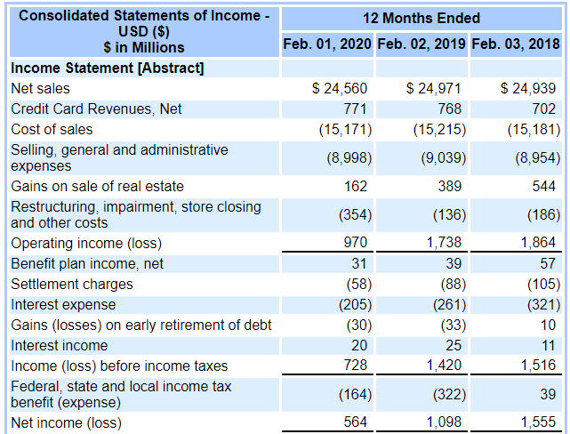
How is this company performing (FYE 20 compared to FYE19)?
Revenues down 2%
Pre-tax income down 64%
Gross margins fell from 39% to 38%
OI fell from 7% to under 4%
Impacted by Gains and restructuring
Macy’s

Slide 15
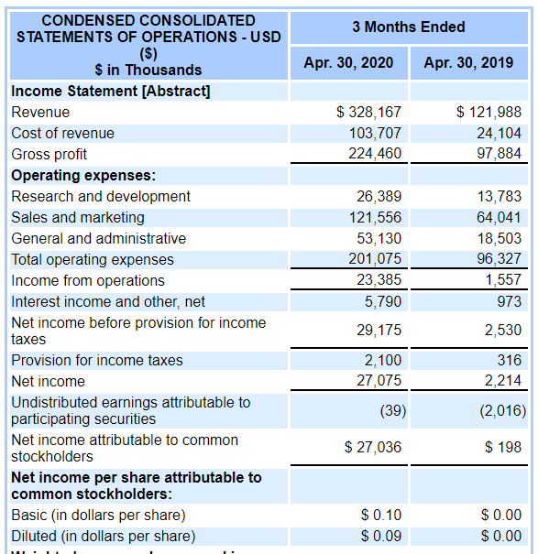
A company’s gross margins decreased from 80% to 68%. How do you expect net income to be impacted?
It actually grew by 1123%. How?
Net Revenues up 169%
Operating margins up from 1% to 7%
Op exp down from 79% to 61%
Sales/marketing less than doubled when sales almost tripled
Zoom (quarterly results).
Stock price up 87% from 4/30/19 to 4/30/20
Markets down 1%

Slide 16
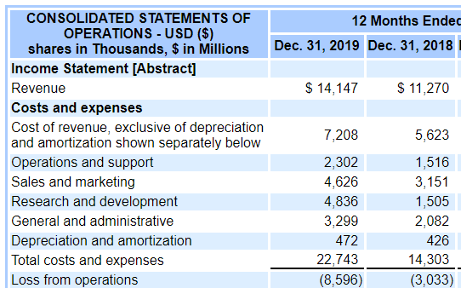
A company grew revenues by 25% and saw its gross margins decrease from 50% to 49%.
How would you expect Operating Income to change?
Operating loss nearly tripled. How?
SG&A went from 77% of revenue to 110%
R&D more than tripled
Uber

Slide 17
What information are companies focusing on in their earnings releases? 2021 4th quarter releases from five of Minnesota’s largest public companies

Slide 18
i

Slide 20
s

Slide 23
Items listed
Revenue growth
EPS
Comparable (organic) sales growth
OI as a % of sales
Dividend increase
Operating cash flow growth
Debt reduction
Free cash flow conversion

Slide 25
Key Ratios in Analyzing Financial Statements (Boz’s Opinion)
Growth
Percent change in revenue
Percent change in EPS (GAAP and adjusted)
Profitability
Gross margin as a % of Net Revenues
Operating Income a % of Net Revenues (GAAP and adjusted)
Asset Utilization
Days Receivables
Days Inventories
Liquidity
Current Ratio
Leverage Ratio

Slide 26
Less Critical Ratios in Analyzing Financial Statements (Boz’s Opinion)
ROA, ROE, ROIC, Debt-Equity
Can vary wildly based on book vs. market value of assets, which often depends on whether a company grew organically or through acquisitions
Okay to use when comparing a company’s performance over time, but tough to compare to peers
More valid if market equity is used. Problem?
Market value is constantly changing

Slide 27
Less Critical Ratios in Analyzing Financial Statements (Boz’s Opinion)
Some prefer EBITDA as a % of Net Revenues, instead of OI as a % of Net Revenues,
OI better factors in capital expenditures (through depreciation)
Ratios involving Free Cash Flows (Cash flows from Operating Activities less Capital Expenditures) arguably most effective
Cash is more subject to manipulation than income
P/E is very important, but isn’t used in evaluating financial statements

Slide 28
Using Ratios
Don’t look at them in a vacuum
Compare them to two things:
Company’s performance over time
Peers’ performance over time

Slide 29
When comparing to company performance over time
Some ratios will naturally change over time
Can’t grow at a higher rate forever
Tough to be profitable if investing heavily in R&D and marketing
Exclude one-time items (COVID-19)
Be careful that these one-time items don’t simply recur every year
Recurring “non-recurring” items
Improving in one area could cause issues in another area
e.g., Driving sales growth by expanding inventory selection, relaxing payment terms or credit standards

Slide 30
When comparing to peers
Important to identify peers and aspirants
Try to identify at least several peers
Can look at full range, but also focus on medians and averages
Be aware of limitations in your company’s strategy which will make it impossible to measure up to peers at times
Target will not have same turnover ratios as Costco or Wal-Mart
Some banks will take more aggressive approaches or value customer service (higher margins) over maximizing number of loans processed

Slide 31
Companies to examine
Minnesota-headquartered companies
3M – Diversified manufacturer. Sells to retailers
Ecolab – Water treatment and cleaning products. Sells to businesses
Hormel – Branded food company. Sells to grocery stores
Target – Retailer. Sells to consumers
United Health – Managed healthcare and insurance. Sells to businesses and individuals
Xcel Energy – Utility company. Sells to businesses and individuals

Slide 32
Companies to examine
Notable companies
Amazon – Online sales, cloud computing, digital streaming, and AI. Sells to individuals and businesses
Apple – Electronics, software, and online services. Sells to individuals and businesses
AT&T – World’s largest telecom company. Sells to individuals and businesses
Boeing – Aircraft and aerospace manufacturers. Sells to airlines and the government

Slide 33
Any predictions?
Company | % Change in Revenues | % Change in EPS | Gross margin ratio | OI % of Sales | Days receivables | Days inventories | Current ratio | Leverage Ratio
3M | 33.3% | 71.3% | 41.8% | 29.8% | 21.2 | 9.1 | 1.1 | 1.0
Amazon | 21.7% | 54.6% | 29.5% | 6.4% | 27.1 | 37.8 | 1.1 | 0.8
Apple | 18.5% | -0.5% | 16.9% | 9.9% | 25.6 | 47.1 | 2.1 | 2.5
AT&T | 16.5% | 6.0% | 56.4% | 16.4% | 26.3 | 36.4 | 0.8 | 5.4
Boeing | 13.3% | 63.1% | 29.3% | 8.4% | N/A | 59.8 | 1.0 | 1.2
Ecolab | 11.8% | 12.9% | 24.2% | 8.3% | 17.2 | N/A | 0.8 | 1.7
Hormel | 9.9% | 8.4% | 46.8% | 20.8% | 48.3 | 89.6 | 1.7 | 1.9
Target | 8.0% | 17.1% | 40.2% | 12.6% | 68.1 | 66.5 | 1.3 | 3.6
UnitedHealth | 7.1% | -65.8% | 4.8% | -4.7% | 13.5 | 494.3 | 1.3 | (76.7)
Xcel Energy | -1.7% | -469.3% | 39.2% | 13.8% | 40.8 | 12.7 | 0.7 | 3.8

Slide 34
% Change in Revenue
Current Year Net Revenues – Prior Year Net Revenues
Prior Year Net Revenues
Higher is…
Better
Median was…
12.6%
Company | % Change in Revenues
3M | 33.3%
Amazon | 21.7%
Apple | 18.5%
AT&T | 16.5%
Boeing | 13.3%
Ecolab | 11.8%
Hormel | 9.9%
Target | 8.0%
UnitedHealth | 7.1%
Xcel Energy | -1.7%
Company | % Change in Revenues
Apple | 33.3%
Amazon | 21.7%
Hormel | 18.5%
Xcel Energy | 16.5%
Target | 13.3%
UnitedHealth | 11.8%
3M | 9.9%
Ecolab | 8.0%
Boeing | 7.1%
AT&T | -1.7%

Slide 35
% Change in EPS
Current Year EPS– Prior Year EPS
Prior Year EPS
Higher is…
Better
Median was…
10.7%
Company | % Change in EPS
3M | 71.3%
Amazon | 63.1%
Apple | 54.6%
AT&T | 17.1%
Boeing | 12.9%
Ecolab | 8.4%
Hormel | 6.0%
Target | -0.5%
UnitedHealth | -65.8%
Xcel Energy | -469.3%
Company | % Change in EPS
Apple | 71.3%
Target | 63.1%
Amazon | 54.6%
Ecolab | 17.1%
UnitedHealth | 12.9%
3M | 8.4%
Xcel Energy | 6.0%
Hormel | -0.5%
Boeing | -65.8%
AT&T | -469.3%

Slide 36
Gross Margin as a % of Net Revenues
Gross Margin
Net Revenues
Higher is…
Better
Median was…
34.3%
Company | Gross margin ratio
3M | 56.4%
Amazon | 46.8%
Apple | 41.8%
AT&T | 40.2%
Boeing | 39.2%
Ecolab | 29.5%
Hormel | 29.3%
Target | 24.2%
UnitedHealth | 16.9%
Xcel Energy | 4.8%
Company | Gross margin ratio
Xcel Energy | 56.4%
3M | 46.8%
Apple | 41.8%
Ecolab | 40.2%
AT&T | 39.2%
Amazon | 29.5%
Target | 29.3%
UnitedHealth | 24.2%
Hormel | 16.9%
Boeing | 4.8%

Slide 37
Operating Income as a % of Net Revenues
Operating Income
Net Revenues
Higher is…
Better
Median was…
11.2%
Company | OI % of Sales
3M | 29.8%
Amazon | 20.8%
Apple | 16.4%
AT&T | 13.8%
Boeing | 12.6%
Ecolab | 9.9%
Hormel | 8.4%
Target | 8.3%
UnitedHealth | 6.4%
Xcel Energy | -4.7%
Company | OI % of Sales
Apple | 29.8%
3M | 20.8%
Xcel Energy | 16.4%
AT&T | 13.8%
Ecolab | 12.6%
Hormel | 9.9%
Target | 8.4%
UnitedHealth | 8.3%
Amazon | 6.4%
Boeing | -4.7%

Slide 38
Days Receivables
365 / Net Revenues
Avg Accts Rec
Higher is…
Worse
Median was…
26.3 days
Company | Days receivables
3M | N/A
Amazon | 68.1
Apple | 48.3
AT&T | 40.8
Boeing | 27.1
Ecolab | 26.3
Hormel | 25.6
Target | 21.2
UnitedHealth | 17.2
Xcel Energy | 13.5
Company | Days receivables
Target | N/A
Ecolab | 68.1
3M | 48.3
AT&T | 40.8
Amazon | 27.1
Xcel Energy | 26.3
Hormel | 25.6
Apple | 21.2
UnitedHealth | 17.2
Boeing | 13.5

Slide 39
Days Inventories
365 / Cost of Goods Sold
Avg Inventories
Higher is…
Worse
Median was…
53.4 days
Company | Days inventories
3M | N/A
Amazon | 494.3
Apple | 89.6
AT&T | 66.5
Boeing | 59.8
Ecolab | 47.1
Hormel | 37.8
Target | 36.4
UnitedHealth | 12.7
Xcel Energy | 9.1
Company | Days inventories
UnitedHealth | N/A
Boeing | 494.3
3M | 89.6
Ecolab | 66.5
Target | 59.8
Hormel | 47.1
Amazon | 37.8
Xcel Energy | 36.4
AT&T | 12.7
Apple | 9.1

Slide 40
Current Ratio
Current Assets
Current Liabilities
Higher is…
Conservative
Median was
1.1
Company | Current ratio
3M | 2.1
Amazon | 1.7
Apple | 1.3
AT&T | 1.3
Boeing | 1.1
Ecolab | 1.1
Hormel | 1.0
Target | 0.8
UnitedHealth | 0.8
Xcel Energy | 0.7
Company | Current ratio
Hormel | 2.1
3M | 1.7
Boeing | 1.3
Ecolab | 1.3
Amazon | 1.1
Apple | 1.1
Target | 1.0
Xcel Energy | 0.8
UnitedHealth | 0.8
AT&T | 0.7

Slide 41
Leverage Ratio
Debt
EBITDA
Higher is…
Aggressive
Median was
1.7
Company | Leverage Ratio
3M | 5.4
Amazon | 3.8
Apple | 3.6
AT&T | 2.5
Boeing | 1.9
Ecolab | 1.7
Hormel | 1.2
Target | 1.0
UnitedHealth | 0.8
Xcel Energy | (76.7)
Company | Leverage Ratio
Xcel Energy | 5.4
AT&T | 3.8
Ecolab | 3.6
Hormel | 2.5
3M | 1.9
UnitedHealth | 1.7
Target | 1.2
Apple | 1.0
Amazon | 0.8
Boeing | (76.7)

Slide 42
The final results!
Company | % Change in Revenues | % Change in EPS | Gross margin ratio | OI % of Sales | Days receivables | Days inventories | Current ratio | Leverage Ratio
Apple | 33.3% | 71.3% | 41.8% | 29.8% | 21.2 | 9.1 | 1.1 | 1.0
Amazon | 21.7% | 54.6% | 29.5% | 6.4% | 27.1 | 37.8 | 1.1 | 0.8
Hormel | 18.5% | -0.5% | 16.9% | 9.9% | 25.6 | 47.1 | 2.1 | 2.5
Xcel Energy | 16.5% | 6.0% | 56.4% | 16.4% | 26.3 | 36.4 | 0.8 | 5.4
Target | 13.3% | 63.1% | 29.3% | 8.4% | N/A | 59.8 | 1.0 | 1.2
UnitedHealth | 11.8% | 12.9% | 24.2% | 8.3% | 17.2 | N/A | 0.8 | 1.7
3M | 9.9% | 8.4% | 46.8% | 20.8% | 48.3 | 89.6 | 1.7 | 1.9
Ecolab | 8.0% | 17.1% | 40.2% | 12.6% | 68.1 | 66.5 | 1.3 | 3.6
Boeing | 7.1% | -65.8% | 4.8% | -4.7% | 13.5 | 494.3 | 1.3 | (76.7)
AT&T | -1.7% | -469.3% | 39.2% | 13.8% | 40.8 | 12.7 | 0.7 | 3.8

Slide 43
Things not always as they seem
Percent change in revenue
Higher is normally better, but…
Costs can get out of control
Percent change in EPS (GAAP and adjusted)
Higher is normally better, but…
Cost-cutting which focused on the short-term
Gross margin as a % of Net Revenues
Higher is normally better, but…
Competitors will eventually catch-up
Operating Income a % of Net Revenues (GAAP and adjusted)
Higher is normally better, but…
Could turnover be increased?

Slide 44
Things not always as they seem
Days Receivables
Lower is normally better, but…
Are tight credit policies restricting sales growth?
Days Inventories
Lower is normally better, but…
Are stockouts more likely?
Current Ratio
Higher is normally conservative, but…
Conservative strategies can lower returns
Leverage Ratio
Lower is normally conservative, but…
Could debt be more effectively utilized?

Slide 45
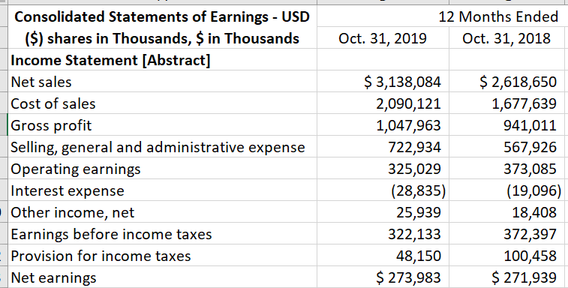
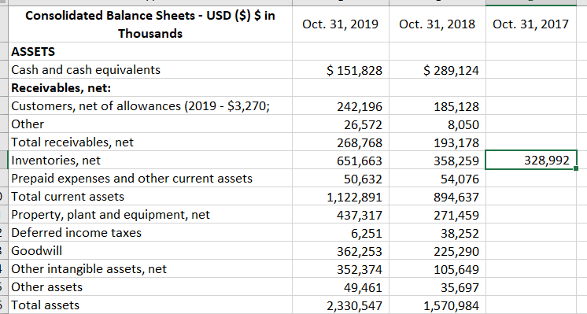
Be careful to consider other factors
How did days inventory change each year?
No averaging
Went from 78 to 114!
With averaging
Went from 75 to 88
Toro. Major acquisition about ½ way through the year.

Slide 46
Boz’s favorite ratio? Good things come to those who grow sales!
 | 2012 | 2013 | 2014 | 2021
Total net sales | 61,093 | 74,452 | 88,988 | 469,822
Cost of sales | 45,971 | 54,181 | 62,752 | 272,344
Fulfillment | 6,419 | 8,585 | 10,766 | 75,111
Marketing | 2,408 | 3,133 | 4,332 | 32,551
Technology | 4,564 | 6,565 | 9,275 | 56,052
G&A | 896 | 1,129 | 1,552 | 8,823
Other Expenses | 159 | 114 | 133 | 62
Income from operations | 676 | 745 | 178 | 24,879
Net income (loss) | (39) | 274 | (241) | 33,364
Total net sales | 100.0% | 100.0% | 100.0% | 100.0%
Cost of sales | 75.2% | 72.8% | 70.5% | 58.0%
Fulfillment | 10.5% | 11.5% | 12.1% | 16.0%
Marketing | 3.9% | 4.2% | 4.9% | 6.9%
Technology | 7.5% | 8.8% | 10.4% | 11.9%
G&A | 1.5% | 1.5% | 1.7% | 1.9%
Other Expenses | 0.3% | 0.2% | 0.1% | 0.0%
Income from operations | 1.1% | 1.0% | 0.2% | 5.3%
Net income (loss) | -0.1% | 0.4% | -0.3% | 7.1%

Slide 47
Final Reminders
Pick ratios that make sense based on the company’s industry
Look for improvement over time, subject to limitations as the company matures
Carefully select peers/aspirants and use benchmarking as one factor in assessing performance
Adjust for unusual items

